Slide 1
Charger distribution for
electric vehiclesin Munich
Presented by

Slide 2
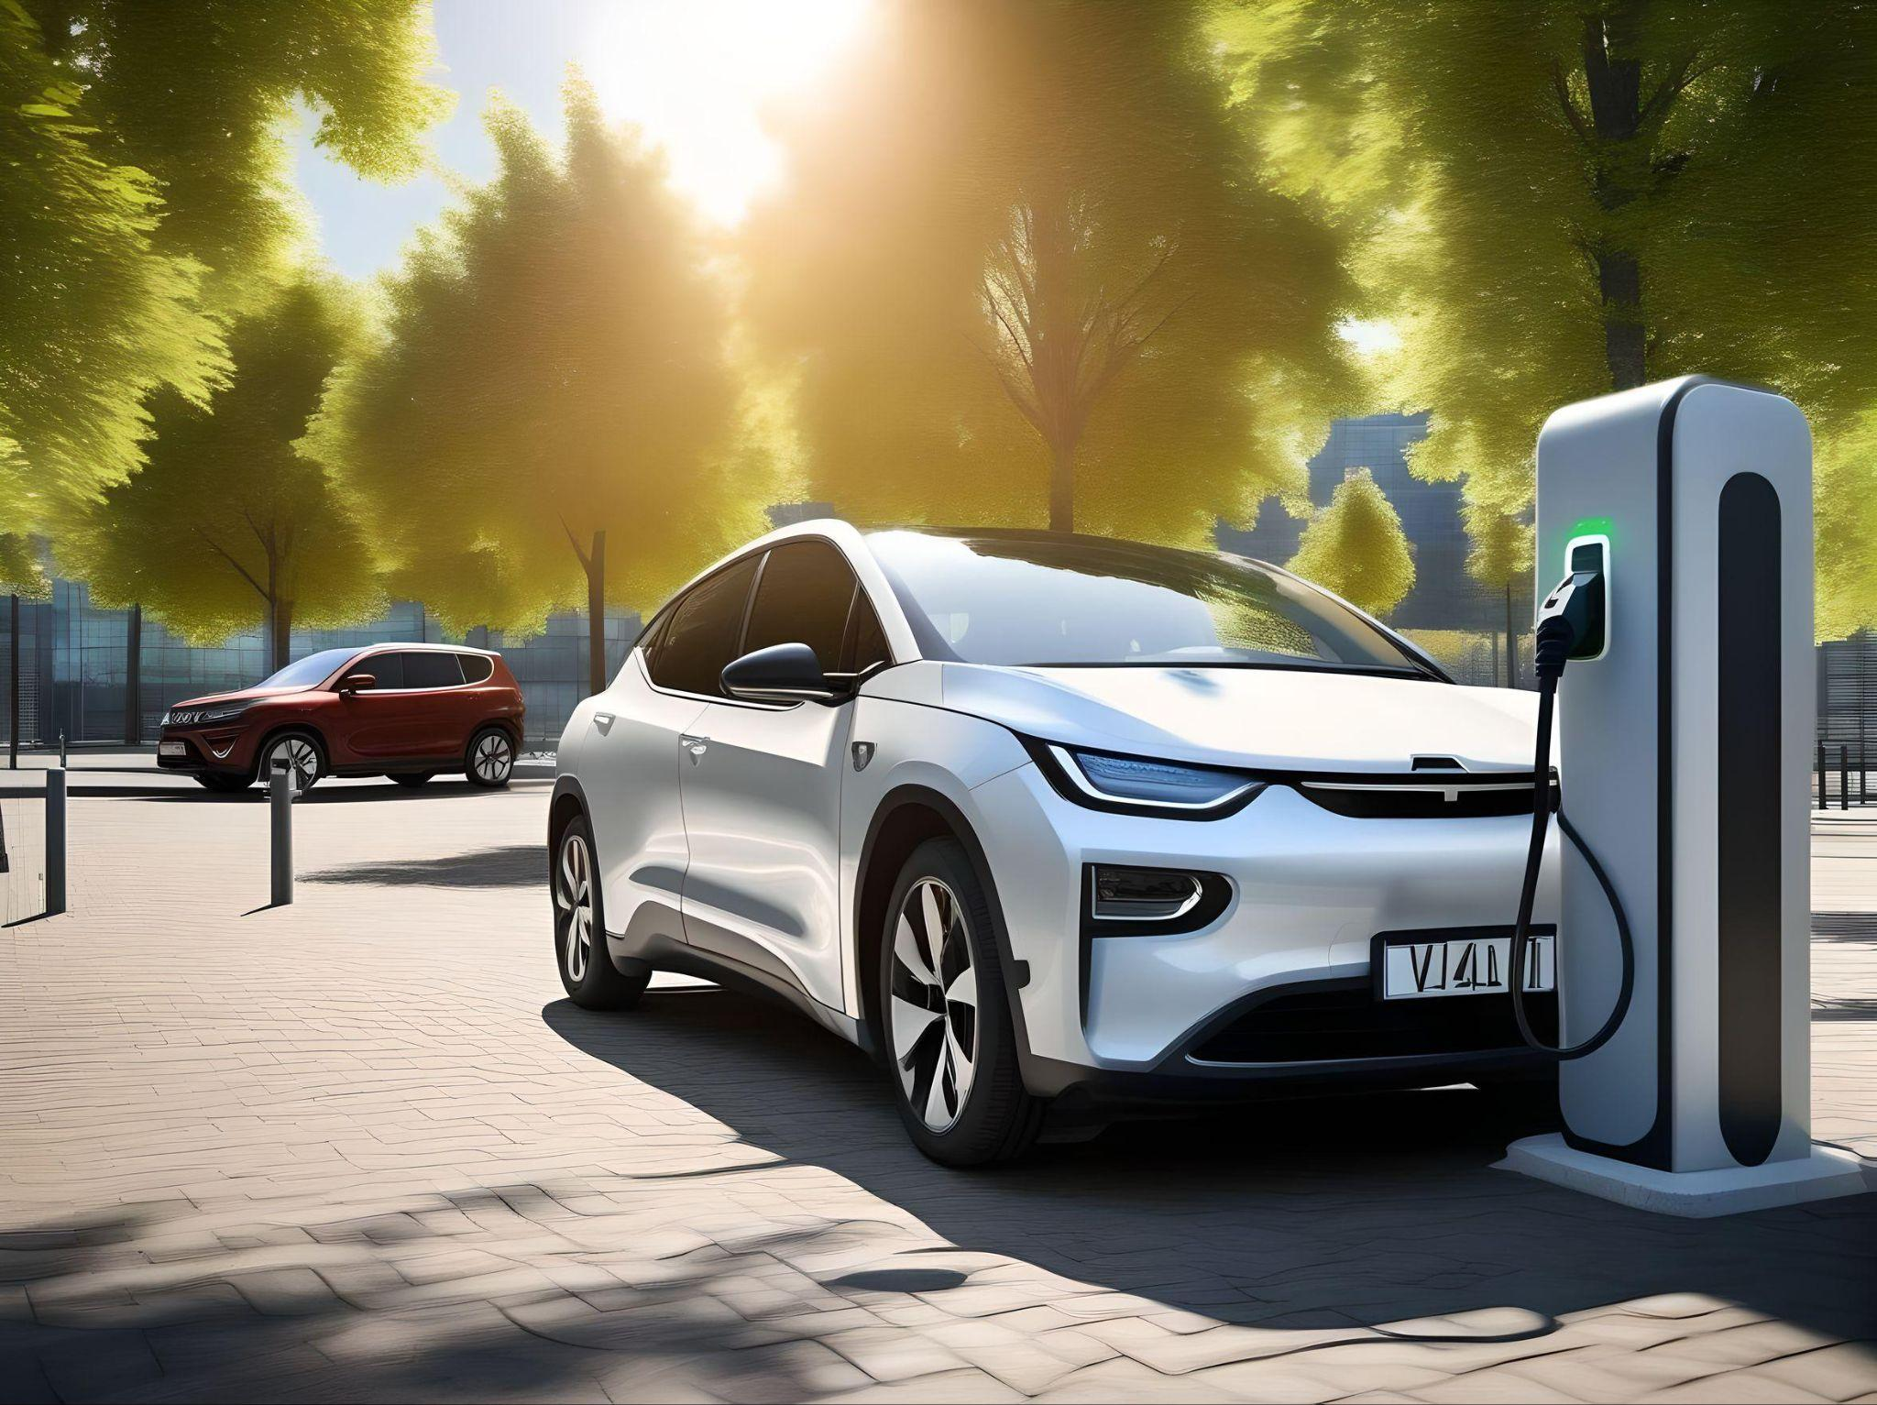
Motivation
How many chargers are available
Where are the chargers located
How is the need for the future

Slide 3
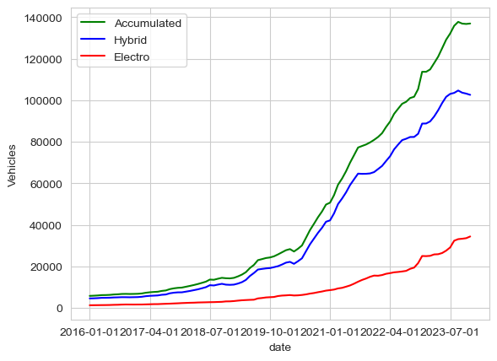
Situation
Electrical cars
In Munich

Slide 4
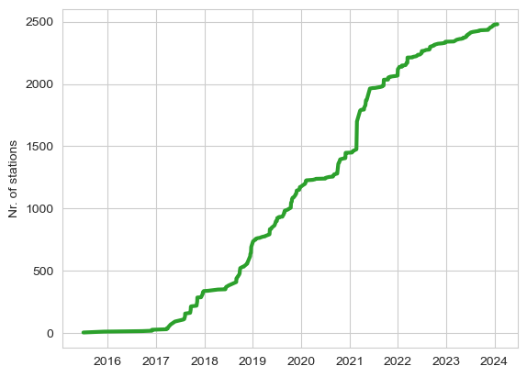
Charger over the years

Slide 5
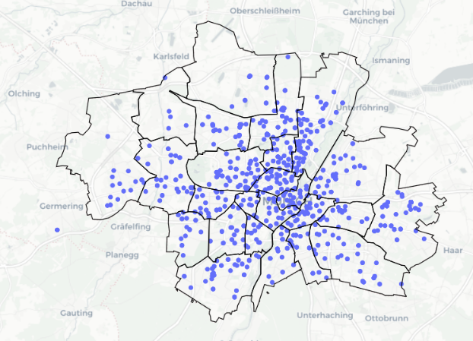
charger location
In Munich

Slide 6
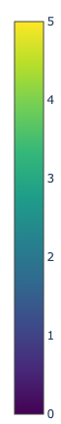
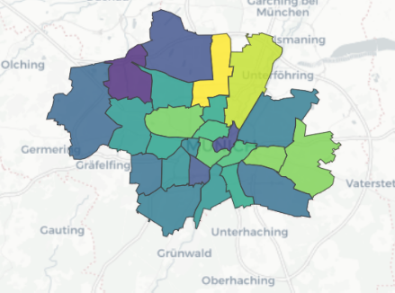
Charger density per district
Per 1000 cars

Slide 7
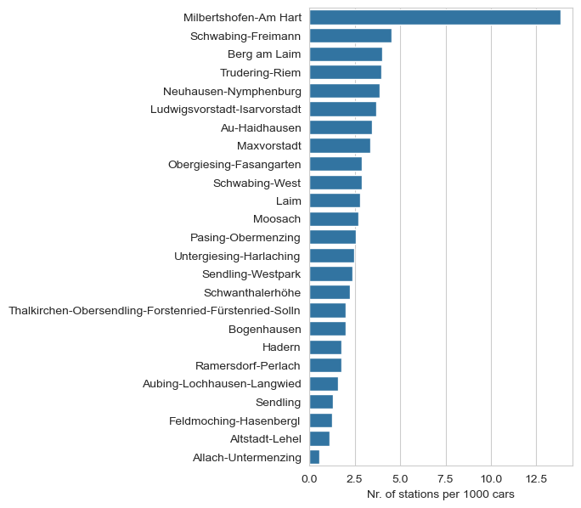
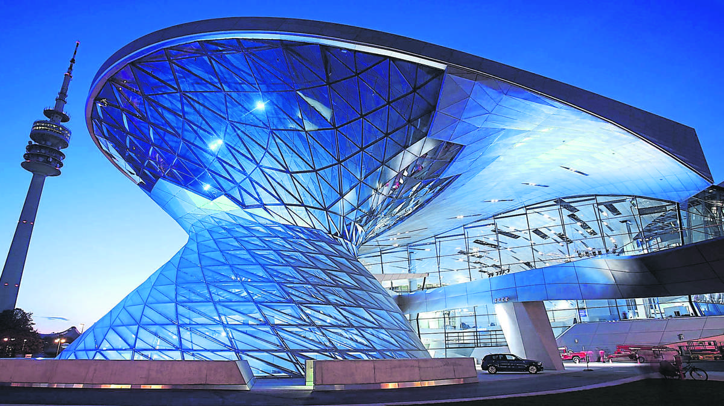
Detail view of districts

Slide 8
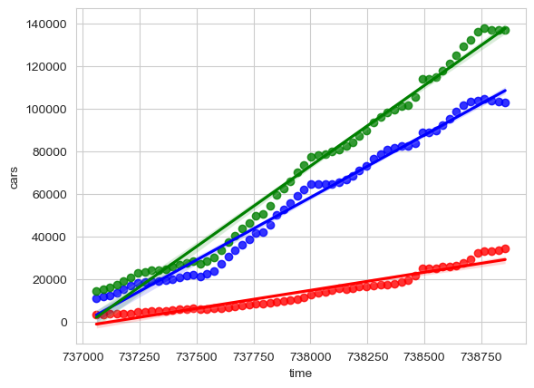
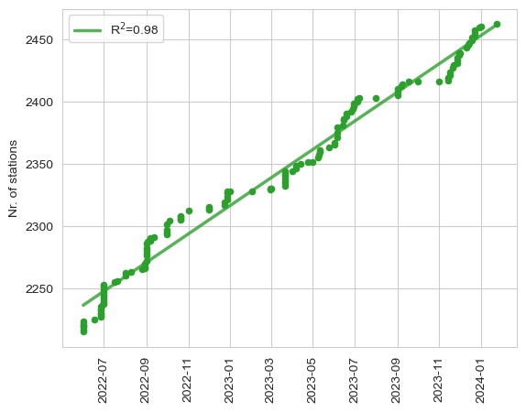
Linear regression and prediction

Slide 9
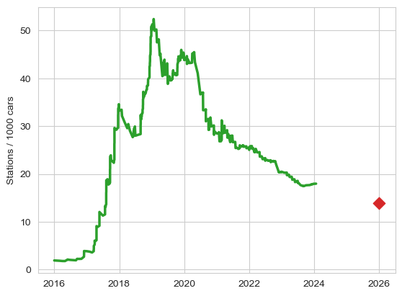
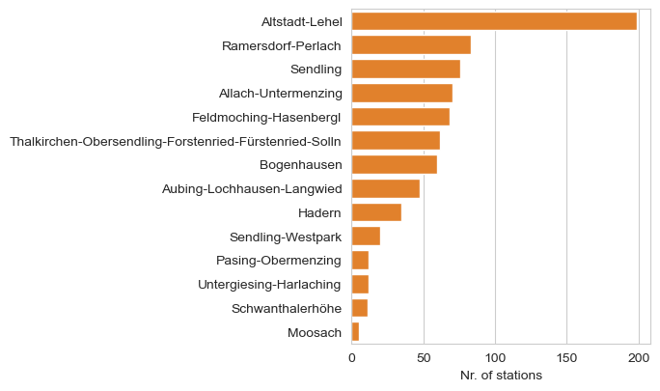
Future demand

Slide 10
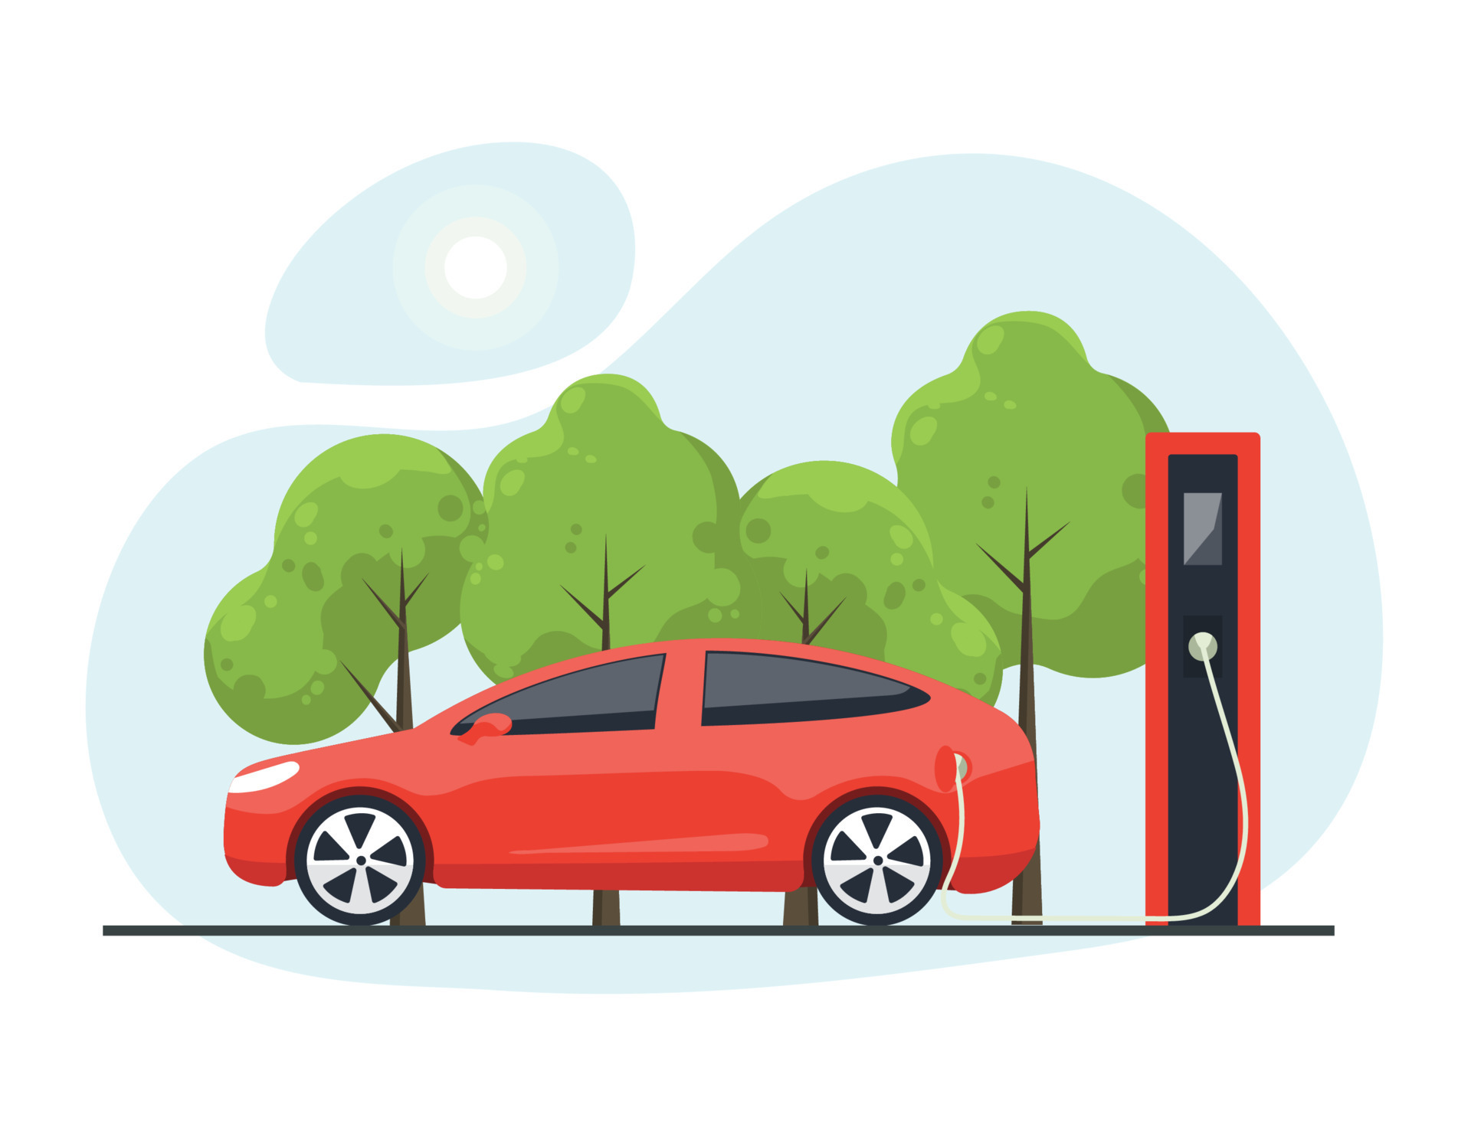
Thanks for your attention

